Slide 1

Unit 7

Slide 2



To learn to use will + do
To learn to use there will be
To be able to predict what a city in the future will be like with the words more, fewer, less.

Slide 3



peace n. 和平 (不可数名词)
peaceful adj. 和平的；安宁的
keep the peace 维持和平
in peace 静静地
build v. (built) 建筑；建造
e.g. The workers are building a bridge over the river.
n. 身材 (be) of medium build 中等身材
building n. 建筑物，房子
e.g. Tall buildings can be seen everywhere in the city.

Slide 4
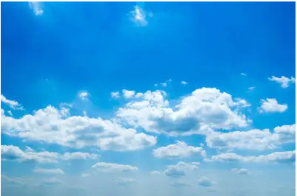
sky n. 天空
sky的复数形式可用来描述天气或某处的天空状况
e.g. a land of blue skies and warm sunshine
拥有蔚蓝色天空和温暖阳光的土地
当只表示“天空”时，sky常用单数形式
in the sky 在天空中
e.g. There wasn't a cloud in the sky.
天空中晴朗无云。

Slide 5

Try to find the rules
肯定句：
We will have robots in our homes in 100 years.
My uncle will come to Beijing next week.
They will study at home on computers in the future.
The environment will be in great danger.
否定句：
We won’t use money in 100 years.
Kids won’t go to school in the future.

Slide 6
一般疑问句：
-- Will people live to be 200 years old?
-- Yes, they will.
-- Will they use money in 100 years?
-- No, they won’t.
-- Will we have to move to other planets?
-- Yes, maybe we will.
-- Will you go out tomorrow?
-- No, I’ll not.

Slide 7
特殊疑问句：
-- What will the future be like?
-- Cities will be more crowded and polluted.
-- What will your life be like in 10 years?
-- I think I’ll be an astronaut.
-- Where will you live?
-- I’ll live on a space station.
-- When will she leave for London?
-- She’ll leave next Sunday.

Slide 8
Review
活到……岁
一百年以后
更少的树木
处于极大危险之中
搬到；搬迁
在地球上
种更多的树
拯救地球
live to be ... years old
in 100 years
fewer trees
be in great danger
move to
on the earth
plant more trees
save the earth

Slide 9
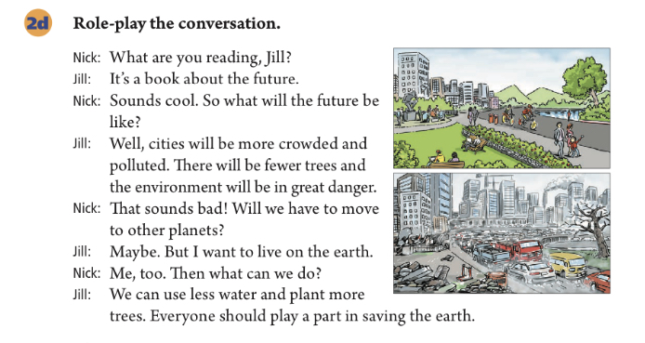

Slide 10


Slide 11
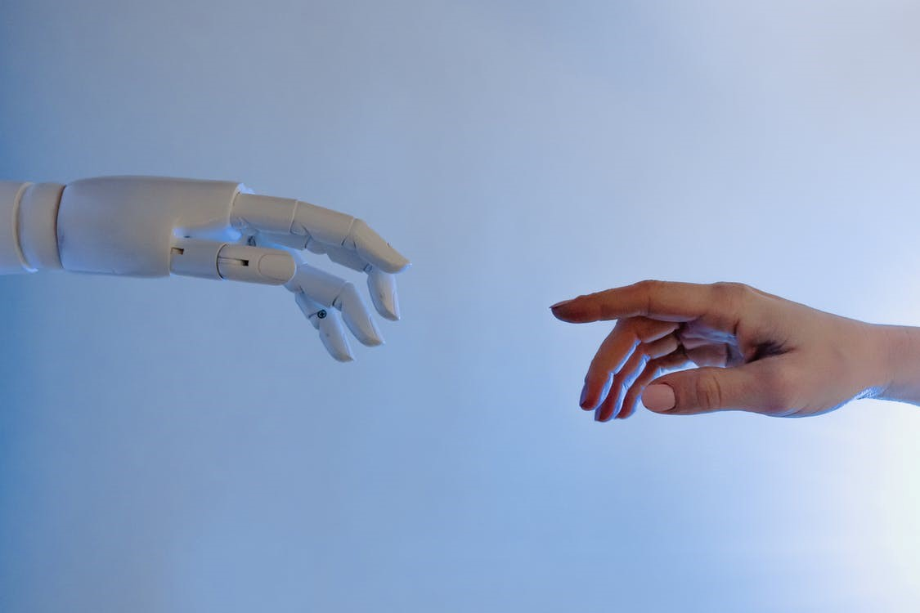
Unit 7
Will people have robots?

Slide 12



Slide 13
Let’s translate!
Complete the following sentences.
1. 将来会是什么样子？
What ______ the future ______ ______?
城市污染将会更多。且树木将会更少。
Cities _____ _____ ______ polluted. And there _____ _____ _____ _____.
will be like
will be more
will be fewer trees

Slide 14
2. 一百年后，人们会使用钱吗？
_____ people _____ money _____ 100 years?
不会。一切东西将会免费。
No, they ______. Everything ____ ____ ____.
3. 世界将会和平吗？
_____ _____ _____ world peace?
是的，我希望如此。
Yes, I _____ _____.
Will use in
won’t
will be
free
Will there be
hope so

Slide 15
4. 孩子们将会在家里的电脑上学习。
Kids _____ _____ at home ____ _________.
他们将不会去学校上学。
They ______ _____ ______ ________.
will study
on computers
won’t go to school

Slide 16

Let’s choose!
Fill in the blanks with more, less or fewer.
1. In the future, there will be ____ fresh water because there will be _____ pollution in the sea.
2. In 100 years, there will be ______ cars because there will be ______ people in the cities.
3. There will be ______ jobs for people because ______ robots will do the same jobs as people.
less
more
more
more
fewer
more

Slide 17
Let’s choose!
Fill in the blanks with more, less or fewer.
4. I think there will be ______ cities because people will build ______ buildings in the country.
5. In 50 years, people will have ______ free time because there will be ______ things to do.
more
more
more
fewer

Slide 18


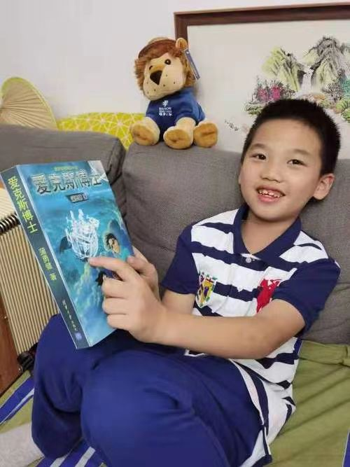
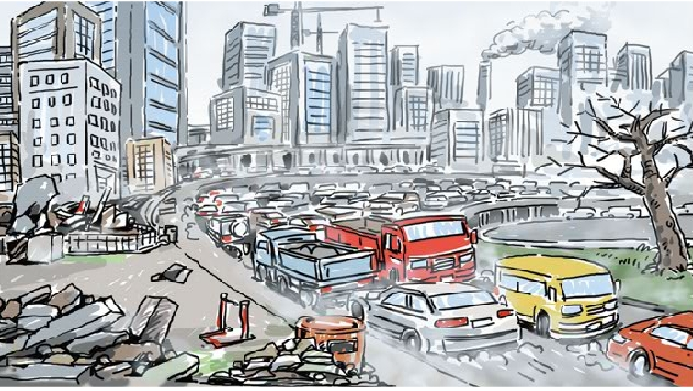
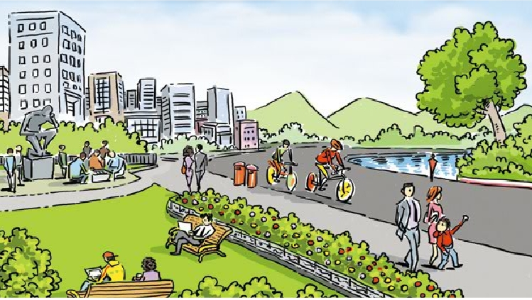
Let’s read!
Listen to the conversation first, read and answer the questions.
——What will the future be like in Jill’s book?
——Cities will be ______ ______ and ______.
There will be ______ ______.
The environment will be ______ ______ ______.
——If we want to live on the earth, what can we do?
——We can ______ ______ ______
and ______ ______ ______.
Everyone should play a part in ______ ______ ______.
more crowded polluted
fewer trees
in great danger
use less water
plant more trees
saving the earth
Jill is reading a
book about the future.

Slide 20


Complete the predictions with what you think will happen.
1. Kids study at school now. In 100 years, __________________
____________________________________________________
they will study at home on computers.
2. I sometimes see blue skies in my city, but in the future, ____________________________________________________
I will see the blue skies almost every day.
3. People now usually live to be about 70-80 years old, but in the future ______________________________________________
4. Family usually spend time together on weekends, but maybe in 200 years _________________________________________
people will live to be more than 100 years old.
family will spend time together every day.

Slide 21

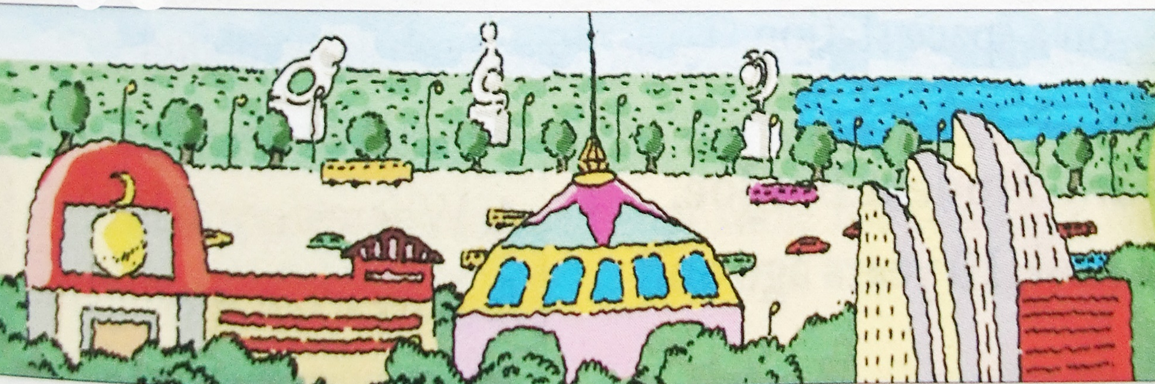
Draw a picture of what you think a city in the future will be like. Then describe it to the class.
I think there will be more tall buildings, and there will be fewer cars and more buses.

Slide 22

活到……岁
一百年以后
更少的树木
处于极大危险之中
搬到；搬迁
在地球上
种更多的树
拯救地球
live to be ... years old
in 100 years
fewer trees
be in great danger
move to
on the earth
plant more trees
save the earth

Slide 24


一般将来时
用法：表示将来某个时间要发生的动作或存在的状态。
构成：助动词will + 动词原形
时间状语：in+时间段, tomorrow, in the future, next year…
否定句式: will + not + 动词原形
缩写: will --- ’ll will not --- won’t
一般疑问句式: Will + 主语 + 其他？
肯定回答：Yes, 主语 + will.
否定回答：No, 主语 + won’t.
主语为第一人称(I和we)时, 常用助动词shall。

Slide 25


be going to结构表将来和一般将来时(will)
一般将来时(will) 常用来客观陈述将来某个时间要发生的动作或存在的状态。
be going to结构表示将要发生的动作或安排，特别是打算、计划、决定要做的事。
e.g. We are going to make the subway better.
I’m going to learn another foreign language next year.
My sister wants to be a school teacher. She’s going to study education.

Slide 26
more songs
更多的歌曲
可数名词
more +
不可数名词
more juice
更多的果汁
less news
更少的消息
less + 不可数名词
fewer students
更少的学生
fewer + 可数名词

Slide 27

1. —Tina wants to know if you _______ to the park with us tomorrow.
—I’d love to. But if it ________, I may go to the library instead. (2021辽宁鞍山)
A. go; will rain B. go; rains
C. will go; rains D. will go; will rain
C

Slide 28
2. —Is Helen here?
—No, she isn't here. She _______ in half an hour.
(2021广西梧州)
A. arrives B. arrived C. will arrive D. has arrived
C
3. Mr. Green ______a new bike for his daughter tomorrow.
(2021吉林)
A. buys B. bought C. will buy
4. You can borrow this film—surely you ________ watching it. (2021河北)
enjoy B. enjoyed
C. will enjoy D. have enjoyed
C
C

Slide 29

Fill in the blanks with more, less or fewer.
1. In the future, there will be ____ fresh water because there will be _____ pollution in the sea.
2. In 100 years, there will be ______ cars because there will be ______ people in the cities.
3. There will be ______ jobs for people because ______ robots will do the same jobs as people.
less
more
more
more
fewer
more

Slide 30
4. I think there will be ______ cities because people will build ______ buildings in the country.
5. In 50 years, people will have ______ free time because there will be ______ things to do.
more
more
more
fewer

Slide 31
Complete the predictions with what (you think) will happen.
1. Kids study at school now. In 100 years, __________________
____________________________________________________
they will study at home on computers.
2. I sometimes see blue skies in my city, but in the future, ____________________________________________________
I will almost see the blue skies every day.
3. People now usually live to be about 70-80 years old, but in the future ______________________________________________
4. Family usually spend time together on weekends, but maybe in 200 years _________________________________________
people will live to be 100 years old.
family will spend time together every day.

Slide 32
Draw a picture of what you think a city in the future will be like. Then describe it to the class.
I think there will be more tall buildings, and there will be fewer cars and more buses.

Slide 33


Will there be more pollution?
Will the air be cleaner?
Will there be more animals in the zoo?
Will our city become more crowded?
Will more people drive their cars to work?

Slide 34


Ⅰ. 根据语境及所给汉语提示，写出所缺内容。
There will be fewer schools in the future
1. ___________________________________(未来将有更少的学校) because children will study at home on computers.
2. We must be quick. ______________________ (几乎没有时间了).
3. I enjoy my life here. ______________________(我有几个好朋友) and we see each other quite often.
4. You need ________________________(多听少说).
There is little time
I have a few good friends
to listen more and talk less

Slide 35
5. __________________________(我不会告诉任何人). I promise.
6. —Hello. Can I speak to Kate, please?
—Just a minute. ______________________(我去叫她).
7. —Goodbye! Have a nice holiday.
—Thanks. _________________________________________
(我会给你寄一张卡片) when I get there.
I won’t tell anyone / anybody
I will get her
I will send you a card / I will send a card to you

Slide 36
Ⅱ. 根据短文内容，用括号内所给动词的正确时态填空，使短文完整、通顺。
Monday, November 2nd
Dear Diary,
I’m angry with my parents again. They (1)_______(be) so strict with me. They don’t let me do anything that has nothing to do with my studies. I wish I could (2)_______(have) my own apartment. I hope there (3)_______(be) a pretty bedroom, a comfortable sofa and a big TV in my apartment. I (4)_______(think) my life will be different and exciting.
are
have
will be
think

Slide 37
After college, I (5)__________(become) a travel (旅行) writer because I like traveling and writing. I (6)_______(fly) to different cities around the world and I (7)_________(meet) interesting and famous people. (8)________(sound) great, doesn’t it? What’s more, I (9)_________(take) up cooking because I like eating delicious food. I will learn to ... Oh, I can’t (10)________(wait) to be older.
will become
will fly
will meet
Sounds
will take
wait

Slide 38


Write a short passage about what you think a city in the future will be like.

Slide 39


